Slide 1
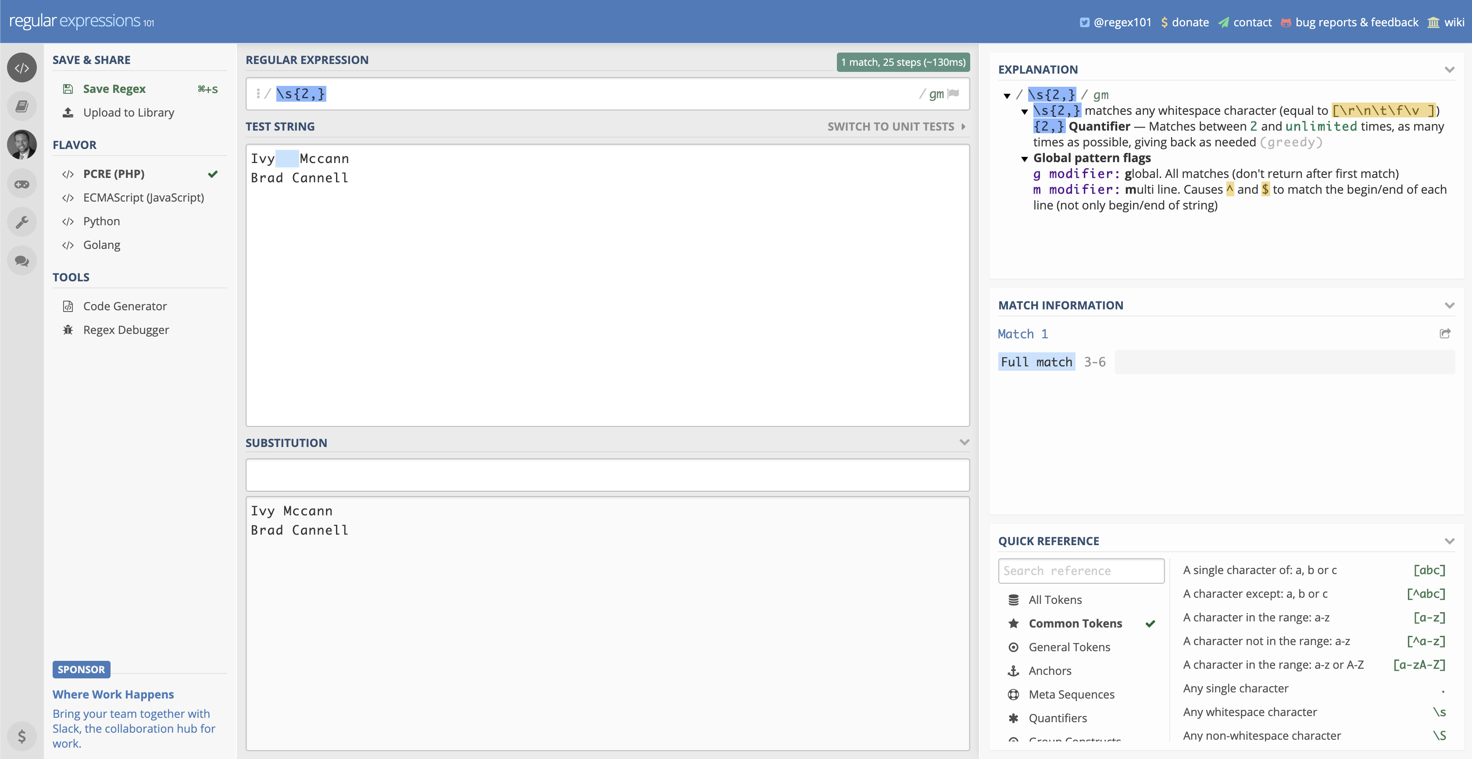
Login
Pattern
String
Explanation
Replacement
Results
Reference

